Slide 1
Admin?
Allow full access
yes
no
Private Groups for the forum exist?
Take most permissive
no
yes
Check if user can perform this under bbpress role?
Deny this level of access, and only allow bbpress role level
Check if user has any of these groups
no
no
yes
yes
Check each user group and if group has topic permission
no
Allow this level of access
yes

Slide 2
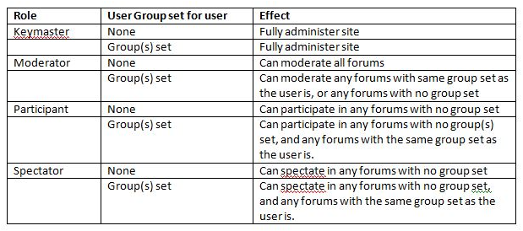

Slide 3
Example
Forum A
User M
Group 1
Only View Topics/Replies
Group 1
Forum B
Group 2
User N
Group 3
User P
Group 1
User Q
Forum C
Group 2
Group 3
User M
User N
Forum D
Group 1
Group 2
User P
Group 3
User Q
Group 1
Group 1
Group 1
Group 1
Group 1
Group 1
Group 1

Slide 4
Example 1
User M
Forum A
Group 1
User N
User P
Forum B
Group 2
User Q
Example 2
User M
Forum A
Group 1
User N
User P
Forum B
Group 2
User Q
Example 3
User M
Forum A
Group 1
User N
User P
Forum B
Group 2
User Q
Forum C
Group 3

